Slide 1
Machine Learning in the age of Mark Zuckerberg v/s Elon Musk
Spandan Madan
Notes:
Ok, quick show of hands -
How many of you have heard of the terms AI, Machine Learning, Deep Learning before. Cool!
And, how many of you came across the recent news debate between Mark Zuckerberg and Elon Musk about the future of AI?
So, for those of you who don’t know, Elon Musk spoke publicly about how AI was dangerous, and zuckerberg said Musk was blowing things out of proportion. And if we take a look at the news, you will see a bunch of such articles.

Slide 2
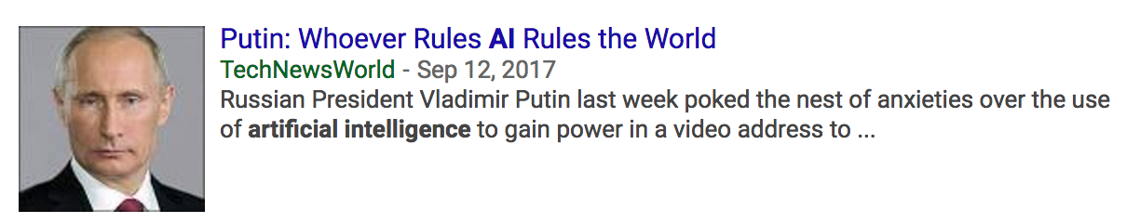




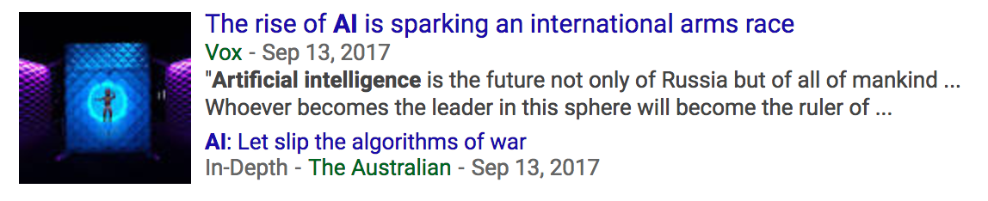
Popular AI news headlines this month
Source: google news
Notes:
These, are some of the popular AI news articles this week. And as we can see, they’re talking about applications ranging from gaming, to medicine, to politics! Do a quick search for applications on google, and you’ll be surprised by the variety of use cases. So, why is this the case? Why do we see machine learning literally everywhere!

Slide 3
Is Machine Learning the MOST revolutionary tech of the past few decades?
Probably NO.
Strong Contenders include :
Quantum Computing
CRISPR
The Cell Atlas
It is more ubiquitously applicable than it is revolutionary.
But, why is it that Machine Learning is SO ubiquitous?
Notes:
Are we to believe that Machine Learning is the one true revolutionary technology which has been discovered in the past 2 decades and there is no other technology which was as important from a scientific perspective?
Well, depends. There are other revolutionary technologies, like quantum computing CRISPR, which have a far greater impact. Quantum Computing will completely change the way all our digital systems work. It will make things like login passwords obselete. CRISPR will enable us to genetically modify and prevent diseases in people!
But yet, you don’t nearly see enough hype about it. Why?
Well, the reason lies in the ubiquity of machine learning.

Slide 4
The ubiquity of M.L.
Machine Learning lets us approximate functions
Functions is mathematic’s way of representing relationships between entities!
M.L. helps predict cause-effect relationships in the real world!
Notes:
When said this way, it seems very straightforward. But really, if you take a class in the math behind machine learning you’ll find out that this assumption is at the heart of M.L.
Cause and effect relationships help us predict a number of things. For example, To predict someone’s music preferences you need to know what is the impact of things like gender, age, nationality on music preferences. Or to mention one of our recent papers, how does people’s perception change if you move around the lay out of text and images on a poster!
It is this capability of predicting relationships that makes M.L. a powerful framework that’s being used across so many disciplines!
But, here’s the catch. The news tends to use terms like Machine Learning, Deep Learning and AI interchangeably. And often times, that leads to confusions in the minds of readers.
So let’s take a moment to differentiate between these!

Slide 5
Machine Learning v/s Deep Learning v/s Artificial Intelligence
Artificial Intelligence — When Machines can act intelligently like humans.
Machine Learning — A mathematical framework often used to solve tasks within Artificial Intelligence (among other uses).
Deep Learning — A specific technique within Machine Learning.
Source: NVIDIA blog

Slide 6
Machine Learning
Consider entities (variables) x and y. Let the values they assume be x_{i} and y_{i.}
We have reason to believe y depends on x, or mathematically – there exists a function f such that y = f(x).
Problem : We don’t know f.
Solution : Find a function g which approximates f, i.e. for any sample y_{i} ~ f(x_{i})
Notes:
For example, let x to be average money a person spends on lunch and y, their nationality. So say xi is $10 and yi is Indian.
I’d be willing to bet that there’s a relationship between x and y. Needless to say it’s a very complicated function. And I don’t know it. So, I approximate it!

Slide 7
Deep Learning
A technique within M.L. to learn complicated functions.
They are neural network models with lots of layers – Deep Models.
Each layer is a simple function approximator, but together combined they can approximate complicated functions!
Notes:
As we saw, some of these functions we may want to approximate may be very complicated. You can’t assume that the function will be a polynomial, or a sin curve, or something we’ve seen before. It could be a function we don’t have a name for.
So, how do we predict something we haven’t seen before. We can’t! But, we only need to approximate it. And we can do that by using the idea that you can combine lots of simple things, to make something very complicated. It’s almost like LEGOs.
So, we now know what Machine Learning is – allows us to approximate cause and effect relationships. Deep Learning is a special kind of method, which relies on combining simple things to get a complicated function. Let’s now come to the biggest buzz word – AI.

Slide 8
Artificial Intelligence
Sum of the parts is greater than the whole (Gestalt Psychology)
Intelligence is more than the individual tasks.
Machine must do infinitely many tasks like humans do, and all at the same time, before we can call them intelligent.
Notes:
Every time a news article says “An AI system is capable of something”, we must remember that anything which performs a single task, no matter how hard the task be is not really intelligent. It is only a tool made by humans.
Most of the work today tries to solve a very, very narrow task. Like detecting an object in a picture. Or translating a language. These are great tools, and people like me spend all our time trying to solve them. But we are far from Making machines that are intelligent.
These tools come with their own set of issues we must address as a society. For example – There was news about a machine learning system that can predict people’s sexual orientation based on pictures, or about how political candidates can sway public opinions using machine learning. And this has social implications we need to worry about. We need to think about how humans will use these powerful tools.
But we don’t even remotely need to worry about how the machines themselves can become intelligent and impact people on their own. And if this doesn’t convince you. Watch this.

Slide 9
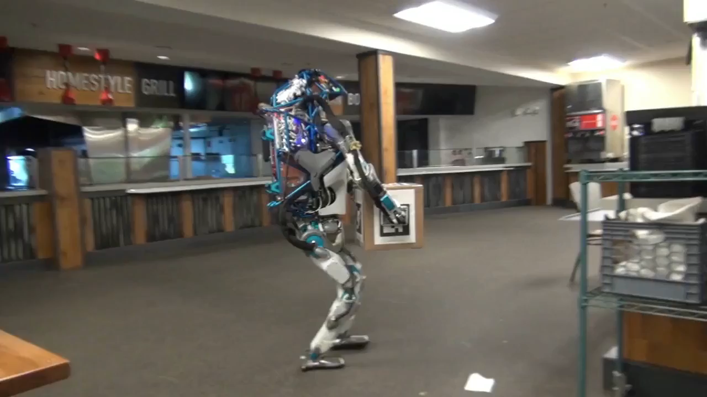

Slide 10
Summary
M.L. : Not as revolutionary as Ubiquitous.
Tool for Cause – effect relationship approximation.
Machine Learning ≠ Deep Learning ≠ Artificial Intelligence
Be weary of incorrect usage or things blown out of proportion when reading the news. Spend 5 minutes reading the original research paper if you are interested.
Think about how people can misuse these powerful tools. We have, so far, made nothing more than tools that can do complicated tasks.
https://github.com/Spandan-Madan/lectures_and_talks

